Slide 1

On Becoming a Leader in Risk Management
Fundamentals of RM
RM System and Process
Leadership in RM
Incident Investigation
RM Tools & Challenges
RM in Industry
People & Org.
Applications & Perspectives
ENGG404 – Lecture
Case 9: The Role of the Engineer & The Nypro Works Explosion, Flixborough UK
.
1
Notes:
ENGG404 Lecture 00 - Day 1
2012 Fall
1
1

Slide 2
Learning Outcomes
At the end of this module, you should be able to:
Assess a situation, recognize your limitations, and apply the two Key Personal Lessons from this case study:
1) Know your limitations.
2) Ask for help!
Case 9: The Role of the Engineer & Nypro Works, Flixborough, UK
2
Notes:
2

Slide 3
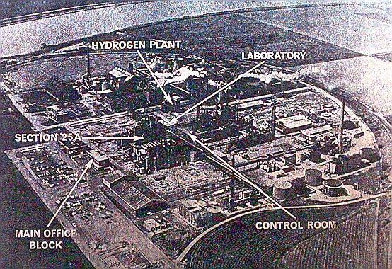
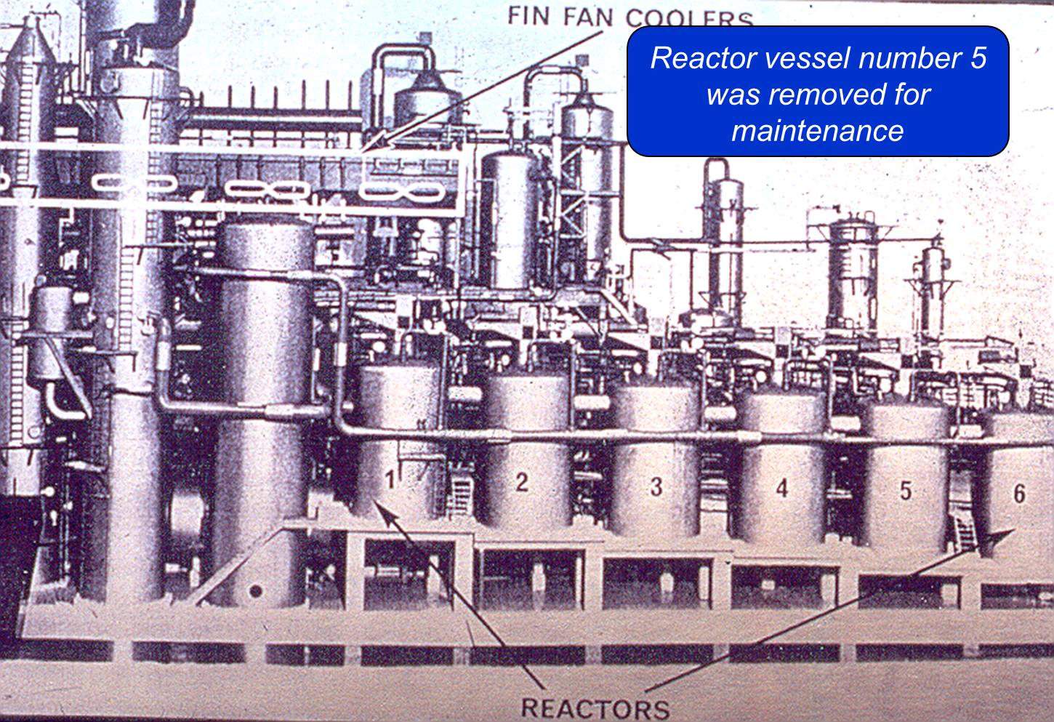
Documentary Videos – Viewed via eClass:
Videos are posted on eClass for viewing prior to the lecture.
Documentary Videos on the Nypro Works, Flixborough, UK; 1-June-1974:
MP4 file LM 10-09-BBC1 FlixboroughUK Disaster
MP4 file LM 10-09-BBC2 FlixboroughUK Disaster
Case 9: The Role of the Engineer & Nypro Works, Flixborough, UK
3

Slide 4
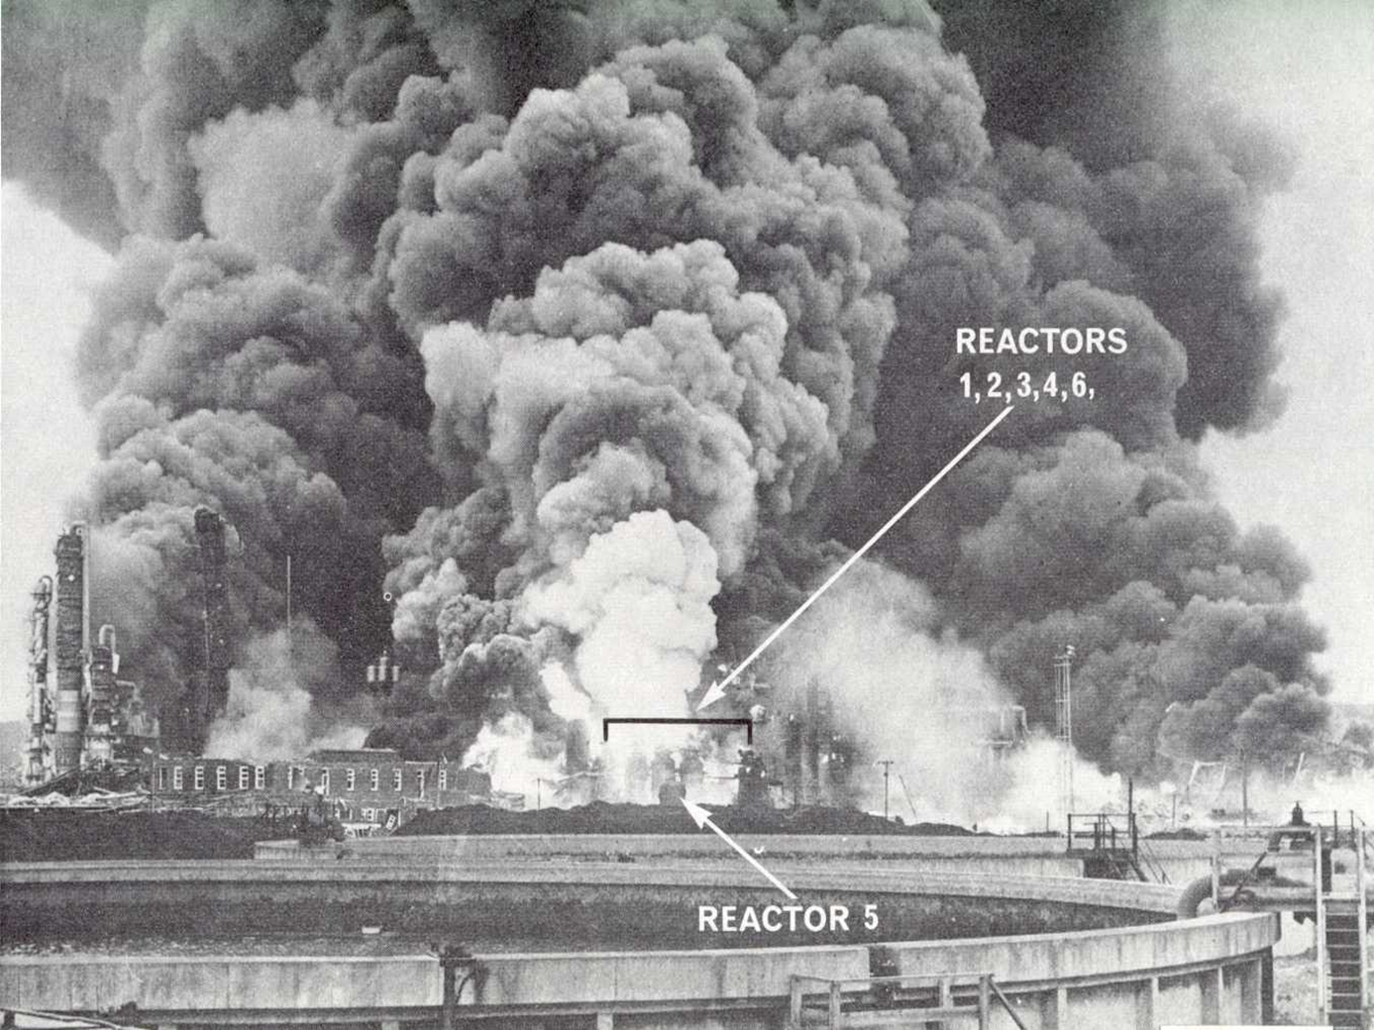
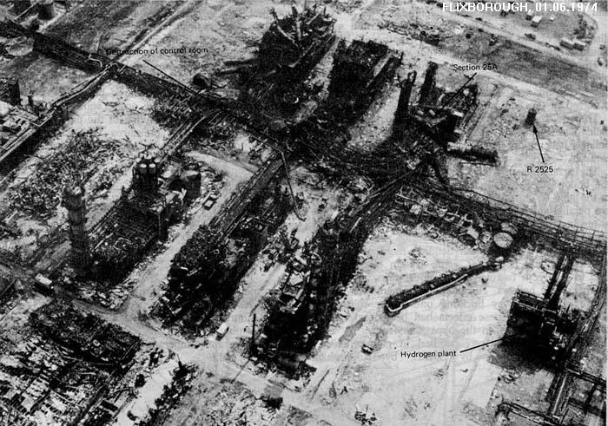
The consequences …
Consequences / Impact on PEAP:
Entire plant levelled.
28 deaths
36 serious injuries
Hundreds of minor injuries
1,821 houses and 167 shops and factories damaged.
Fire burned for 10 days.
Case 9: The Role of the Engineer & Nypro Works, Flixborough, UK
4
Notes:
4

Slide 5
Background: Flixborough Case Study Discussion Points:
Recent Operational History and Events Prior to the Explosion:
Cyclohexane explosions elsewhere.
Cyclohexane leak from Reactor 5
Another cyclohexane leak from Reactor 5
Examination revealed a vertical crack
Decision made to install a bypass pipe … in order to prevent down-time and production loss.
The bypass pipe (termed “dog-leg”) was installed, the plant started up, operated successfully for approximately 2 months, and then the disaster struck.
Let’s examine this using our methods …
SITUATION?
CONCERN?
WHAT SHOULD BE DONE?
Case 9: The Role of the Engineer & Nypro Works, Flixborough, UK
5
Notes:
5

Slide 6
Problems and The Role of the Engineer:
The Situation:
The #5 Reactor has a crack on it.
A replacement vessel or repairs on #5 would require a long production outage.
So, it was decided to bypass #5 in order to maintain production.
Case 9: The Role of the Engineer & Nypro Works, Flixborough, UK
6

Slide 7
Problems and The Role of the Engineer:
The Concern:
Although it is not a bad thing to bypass a reactor, the concern was with how it was done.
A Chemical Engineer with only a little experience in industry designed the bypass consisting of the dog-leg piping, the bellows (expansion joint), and the piping support structure.
He thought he knew enough to do it.
He thought management expected it of him.
He did not realize his professional responsibilities.
Case 9: The Role of the Engineer & Nypro Works, Flixborough, UK
7

Slide 8
Problems and The Role of the Engineer:
Additional Concerns:
No qualified mechanical engineer on site.
Connection between reactors 4 and 6 considered a “routine plumbing job”.
Bellows not designed for thrust.
Manufacturer’s specifications: “Bellows must be aligned unless pipe adequately supported.”
Design standards for bellows ignored.
Inadequate vertical and external support.
Inadequate concern with failure cause of reactors.
Inadequate concern with incidents at other locations with similar technologies.
Was there a “hurry up” attitude?
Case 9: The Role of the Engineer & Nypro Works, Flixborough, UK
8
Notes:
8

Slide 9
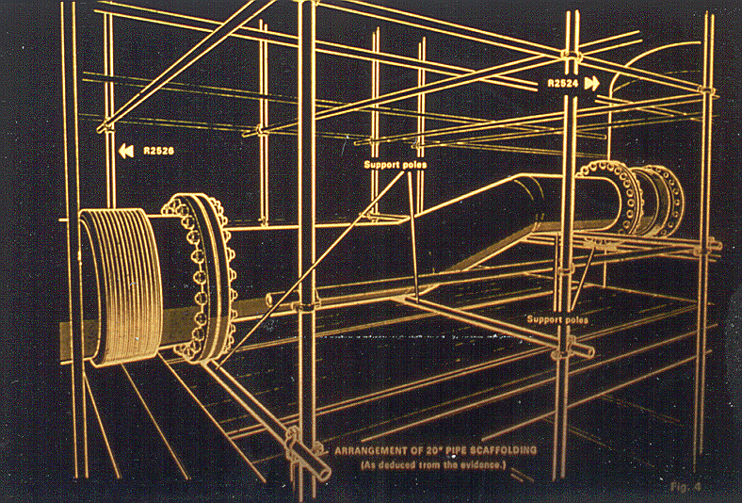
What three concerns do you see?
50 cm diam.
Case 9: The Role of the Engineer & Nypro Works, Flixborough, UK
9
Notes:
9

Slide 10
What three concerns do you see?
1) Reactor #5 was replaced by this 50 cm dog-leg pipe
50 cm diam.
3) Along with these expansion (bellows) joints.
2) With scaffolding as a temporary support.
Case 9: The Role of the Engineer & Nypro Works, Flixborough, UK
10
Notes:
10

Slide 11
Basic Causes:
Engineering and Design Factors:
Available literature, manufacturer’s specifications, on bellows noted only straight connections are safe, and this design specification was not followed.
Job Factors:
No mechanical engineer (of sufficient calibre) on site staff when bypass designed.
Senior management previously advertised for mechanical engineer — should have had temporary solution.
Personal Factors:
A chemical engineer (production, not design) was in charge.
He completed the "temporary" design for the by-pass.
He thought he knew enough … and he was driven to satisfy his manager.
HINT!
Case 9: The Role of the Engineer & Nypro Works, Flixborough, UK
11
Notes:
11

Slide 12
Latent Causes, and Risk Management System Elements:
No one recognized the hazard of installing an inadequately designed piping spool. The risk assessment program for evaluating novel piping spools was inadequate. 2) RAMR
The design process for piping spools allowed deviations beyond manufacturer’s specifications. 7) DC&SU
There was no formal review process to examine, analyse, and assess (evaluate) the change in the piping system before it was being implemented. The MOC Program for managing changes on piping systems was inadequate. 4) MOC
Case 9: The Role of the Engineer & Nypro Works, Flixborough, UK
12
Notes:
12

Slide 13
An Example: Two Key Personal Lessons:
What are your Two Key Personal Lessons that can be taken from the Nypro Works loss incident at Flixborough, UK?
Key Personal Lessons from this case study:
1) Know your limitations.
2) Ask for help!
Have you ever encountered a situation with a problem …
… and don’t know where to start?
… and your supervisor expects you to solve the problem?
When does 30 = 24?
(computer software story – see “Notes”)
Case 9: The Role of the Engineer & Nypro Works, Flixborough, UK
13
Notes:
7/10/2019
13
13

Slide 14
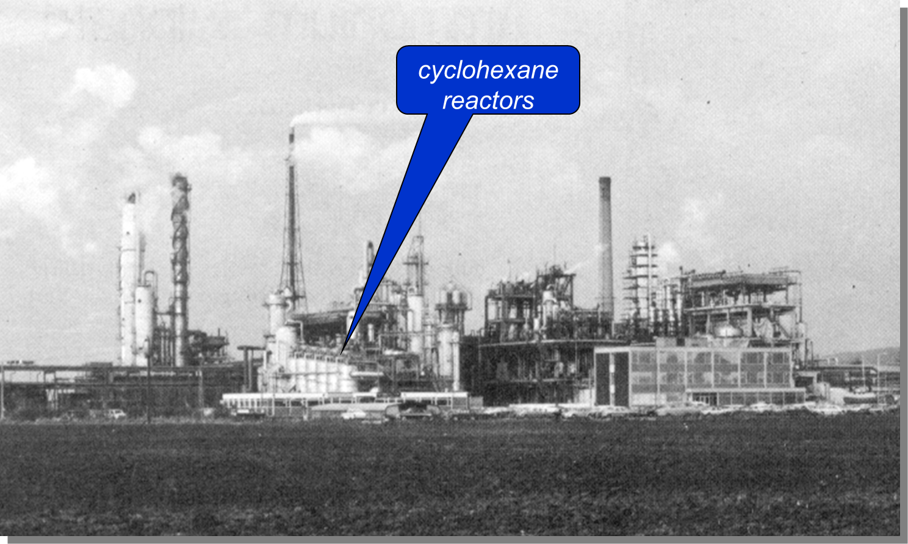

Two Key Personal Lessons:
1) Know Your
Limitations!
2) Ask for Help!
Case 9: The Role of the Engineer & Nypro Works, Flixborough, UK
14
Notes:
14

Slide 15
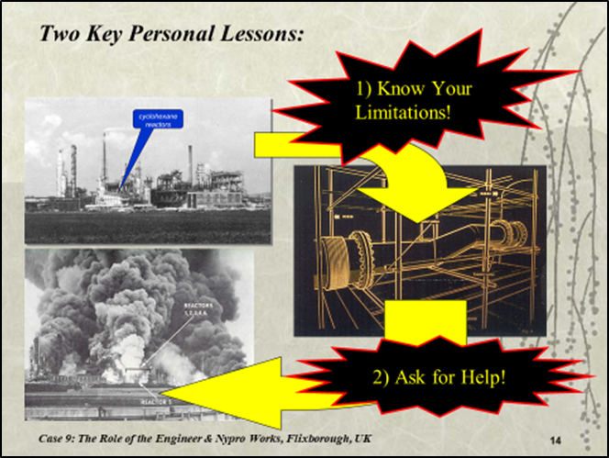
Summary and Two Key Personal Lessons:
Q: Will you encounter a situation with a problem …
… and don’t know where to start?
… and your supervisor expects you to solve the problem?
1) Know your limitations.
Recognize when the work being requested of you is beyond your capabilities.
2) Ask for Help!
It is not as though you can “refuse to do the job”!
Engage subject-matter experts.
Consult in teams, especially at redesign, and with original designers.
This is how you build your expertise!
Case 9: The Role of the Engineer & Nypro Works, Flixborough, UK
15
Notes:
15

